Slide 1

AWS (AMAZON WEBSERVICES)
Submitted By:-
ABHISHEK KUMAR
Roll no:-15110127
C.S.E.(2K15) 2 MONTHS SOFTWARE TRAINING

Slide 2
Overview
AWS
Types of site : Subsidiary
Key people : Andy Jassy (CEO)
Industry : Web services, cloud computing
Subsidiaries Annapurna Labs AWS Elemental
Website aws.amazon,com
Launched March 2006: 12 years

Slide 3
AWS AUTO SCALING
AWS Auto Scaling enables you to configure automatic scaling for the AWS resources that are part of your application in a matter of minutes. The AWS Auto Scaling console provides a single user interface to use the automatic scaling features of multiple AWS services. You can configure automatic scaling for individual resources or for whole applications.
With AWS Auto Scaling, you configure and manage scaling for your resources through a scaling plan. The scaling plan uses dynamic scaling and predictive scaling to automatically scale your application’s resources. This ensures that you add the required computing power to handle the load on your application and then remove it when it's no longer required.

Slide 4
The following instructions are for a configuration template that defines your EC2 instances, creates an Auto Scaling group to maintain the healthy number of instances, and optionally deletes this basic infrastructure. This tutorial assumes that you are familiar with launching EC2 instances and have already created a key pair and a security group.
Tasks
Step 1: Create a Launch Template
Step 2: Create an Auto Scaling Group
Step 3: Verify Your Auto Scaling Group
Step 4: (Optional) Delete Your Scaling Infrastructure

Slide 5
Step 1: Create a Launch Template
For this step, you create a launch template that specifies the type of EC2 instance that Amazon EC2 Auto Scaling creates for you. Include information such as the ID of the Amazon Machine Image (AMI) to use for launching the EC2 instance, the instance type, key pairs, security groups, and block device mappings.
To create a launch template for an Auto Scaling group
Open the Amazon EC2 console at https://console.aws.amazon.com/ec2/.
2.On the navigation bar, select a region. The Amazon EC2 Auto Scaling resources that you create are tied to the region you specify and are not replicated across regions. For more information, see Example: Distributing Instances Across Availability Zones.
3.On the navigation pane, choose Instances, Launch Templates.
4.Choose Create launch template.

Slide 6
5.Choose Create a new template. Provide a name and description for the launch template.
6.For AMI ID, choose an AMI ID from which to launch an instance. The Amazon Machine Image (AMI) serves as templates for your instances.
7.For Instance type, choose a hardware configuration that is compatible with the AMI that you specified.
8.(Optional) For Key pair name, type the name of the key pair to use when connecting to your instances.
9.(Optional) For Network type, choose whether to launch your instances into a VPC or EC2-Classic, if applicable
10.Skip Security Groups to configure a security group as part of the network interface. You cannot specify security groups in both places

Slide 7
11.For Network interfaces, configure Auto-assign public IP and Security group ID. To launch instances into a VPC, you must specify a security group that is created for that VPC. You can leave the other fields empty and this creates a primary network interface with IP addresses that we select for your instances.
12.(Optional) For Storage (Volumes), specify volumes to attach to the instances in addition to the volumes specified by the AMI you specified.
13.(Optional) For Tags, specify one or more tags to associate with the instances and volumes.
14.Choose Create launch template.
15.On the confirmation page, choose Create Auto Scaling group.

Slide 8
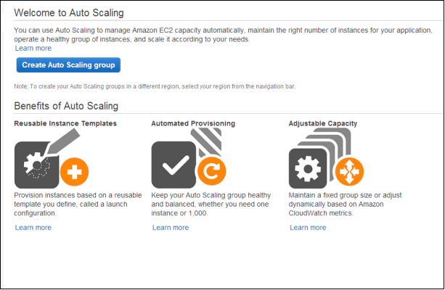
To create a launch configuration
Open the Amazon EC2 console at https://console.aws.amazon.com/ec2/.
On the navigation bar, select a Region. The Auto Scaling resources that you create are tied to the Region that you specify and are not replicated across Regions. For more information, see Example: Distributing Instances Across Availability Zones.
On the navigation pane, under Auto Scaling, choose Auto Scaling Groups.
On the Welcome to Auto Scaling page, choose Create Auto Scaling group.

Slide 9
On the Create Auto Scaling Group page, choose Launch Configuration, Create a new launch configuration, and then choose Next Step.
For the Choose AMI step, there is a list of basic configurations, called Amazon Machine Images (AMIs), that serve as templates for your instances. Choose Select for the Amazon Linux AMI.
For the Choose Instance Type step, select a hardware configuration for your instances. We recommend that you keep the default, a t2.micro instance. Choose Next: Configure details.
Note
T2 instances must be launched into a subnet of a VPC. If you select t2.micro instance but don't have a VPC, one is created for you. This VPC includes a public subnet in each Availability Zone in the region

Slide 10
For the Configure details step, do the following:
For Name, type a name for your launch configuration (for example, my-first-lc).
For Advanced Details, select an IP address type. If you want to connect to an instance in a VPC, you must select an option that assigns a public IP address. If you want to connect to your instance but aren't sure whether you have a default VPC, select Assign a public IP address to every instance.
Choose Skip to review.
For the Review step, choose Edit security groups. Follow the instructions to choose an existing security group, and then choose Review.
For the Review step, choose Create launch configuration.
Complete the Select an existing key pair or create a new key pair step as instructed. You won't connect to your instance as part of this tutorial. Therefore, you can select Proceed without a key pair unless you intend to connect to your instance.
Choose Create launch configuration. The launch configuration is created and the wizard to create an Auto Scaling group is displayed

Slide 11
Step 2: Create an Auto Scaling Group
An Auto Scaling group is a collection of EC2 instances, and the core of Amazon EC2 Auto Scaling. When you create an Auto Scaling group, you include information such as the subnets for the instances and the initial number of instances to start with.
Use the following procedure to continue where you left off after creating the launch template.
To create an Auto Scaling group
For the Configure Auto Scaling group details step, do the following:
For Group name, type a name for your Auto Scaling group (for example, my-first-asg).
For Launch template version, choose whether the Auto Scaling group uses the default, the latest, or a specific version of the launch template when scaling out.

Slide 12
For Fleet Composition, choose Adhere to the launch template.
Kep Group Composition,choose Adhere to launch template.
Keep Network set to the default VPC for the region, or select your own VPC.
For Subnet, choose a subnet for the VPC.
Choose Next: Configure scaling policies.
On the Configure scaling policies page, select Keep this group at its initial size and choose Review.
On the Review page, choose Create Auto Scaling group.
On the Auto Scaling group creation status page, choose Close

Slide 13
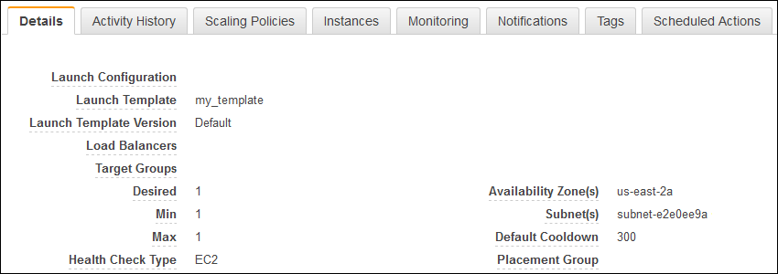
Step 3: Verify Your Auto Scaling Group
Now that you have created your Auto Scaling group, you are ready to verify that the group has launched an EC2 instance.
To verify that your Auto Scaling group has launched an EC2 instance
On the Auto Scaling Groups page, select the Auto Scaling group that you just created.
The Details tab provides information about the Auto Scaling group.

Slide 14
On the Activity History tab, the Status column shows the current status of your instance. While your instance is launching, the status column shows In progress.
the status of successful after the instance is launched. You can also use the refresh button to see the current status of your instance.
On the Instances tab, the Lifecycle column shows the state of your instance. You can see that your Auto Scaling group has launched your EC2 instance, and that it is in the Inservice lifecycle state. The Health Status column shows the result of the EC2 instance health check on your instance.

Slide 15
Thanks

